Slide 2
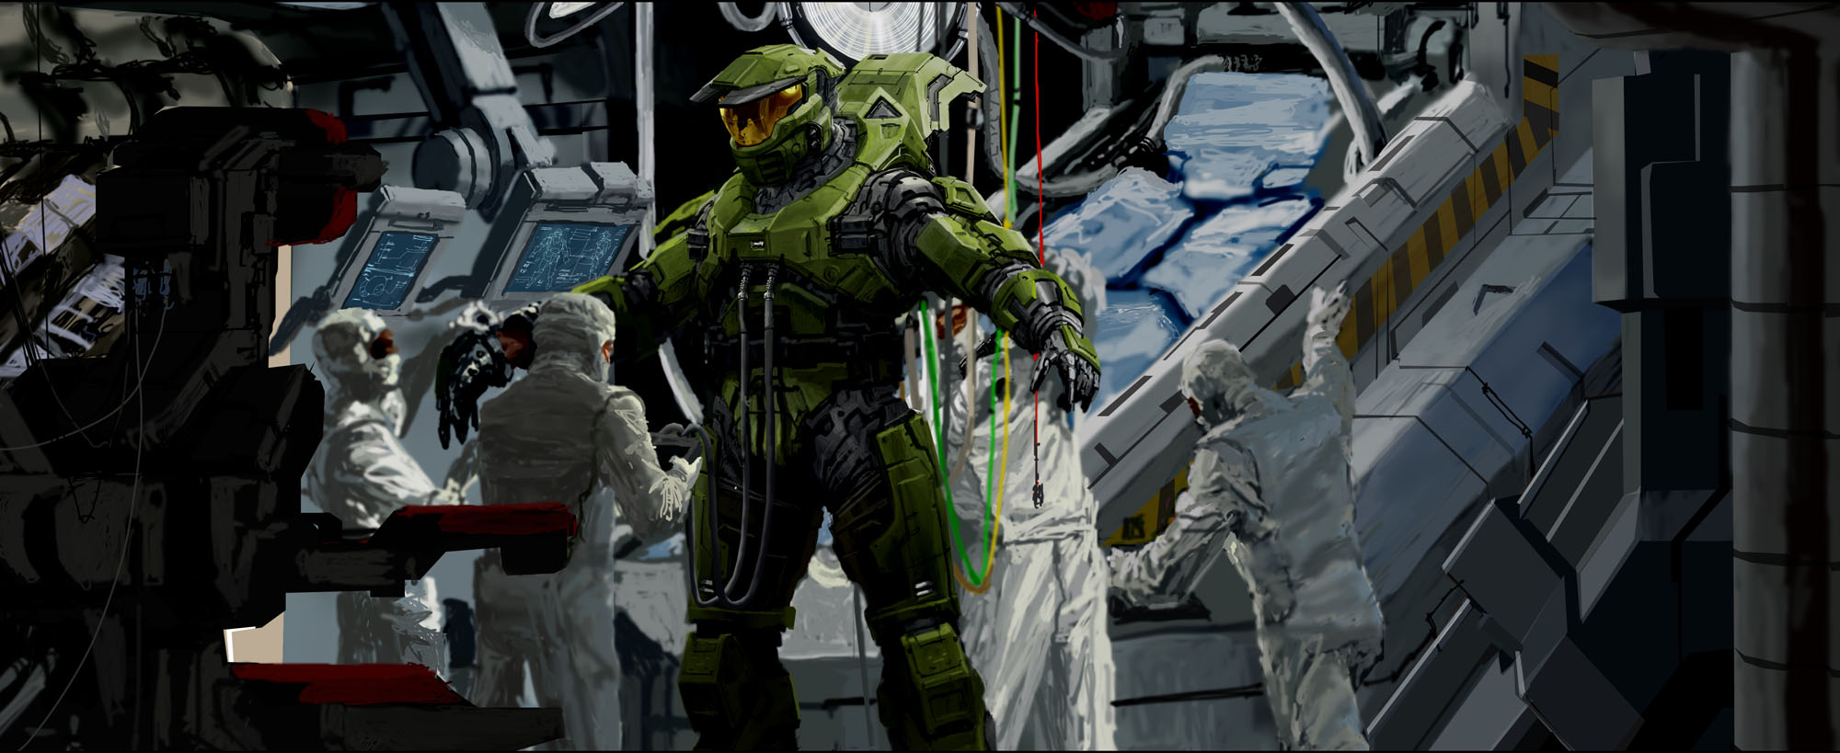
Modular Procedural Rigging
GDC 2009
David Hunt, BUNGIE
Notes:
I’m David Hunt from Bungie and this is Modular Procedural Rigging
First let me say what a huge honor to get to present here at GDC. This is one of the main places where I have come to learn about how to do what I do.
Acknowledge the audience.

Slide 3
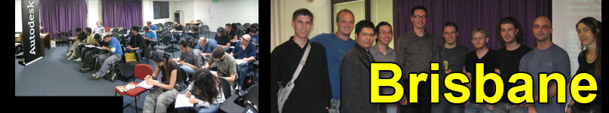

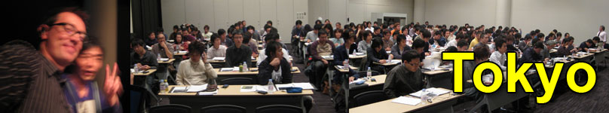
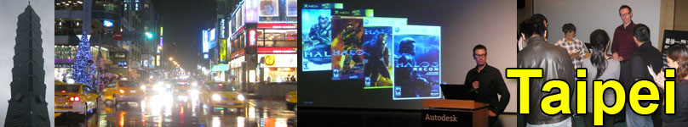
Bungie Autodesk Masterclass
Notes:
Material in this session was originally written for the Bungie Autodesk Masterclass
In November of 2008 I delivered this as a 3 hour class at each of these locations
The material here has been optimized for a shorter format.
Although I will talk a lot about specific mechanics of developing Maya the general theory is applicable to any 3d application: Max, Maya, Softimage, etc.

Slide 4
Contents
Introduction: Animation at Bungie
The Problem of Maya Scene Traversal
Solution:
Semantic Traversal
Building a Metadata Node Network
Modular Procedural Rigging
Architecting a Rig Script Library
Modular Rig Components and Templates
Distributing Rig Updates
Animation Retargeting
Conclusions: The Way Forward

Slide 5
Definition of Terms
Metadata:
Information about information
Semantic Traversal:
Search animation scene using human terminology
“I am a character” (attribution)
“Here are my arms” (node connections)
Explicit Traversal:
Search animation scene using technical terminology
PoleVector constraint connected to ikHandle
Elbow joint is located at position X,Y,Z

Slide 6
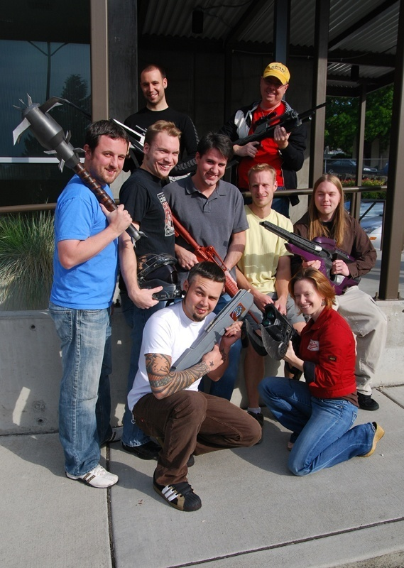
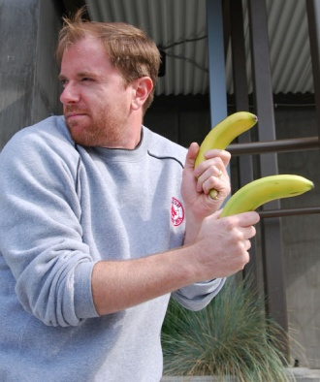
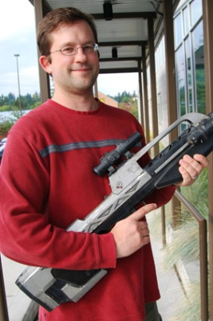
Bungie Animators
Diversity brings innovation
A worthwhile challenge for Tech-Artists
My role: Character Rigger

Slide 7
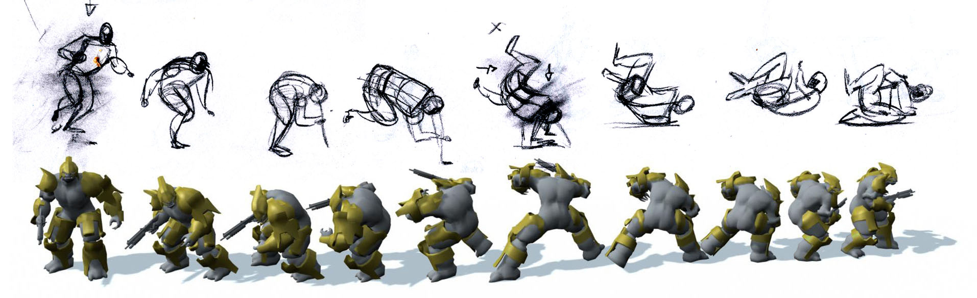
What Animators Want
WANT:
My idea in reality as fast as possible
Fewest possible obstacles to creativity
ITERATE, play it, integrate, collaborate
NEED: Fast, effective tools

Slide 8
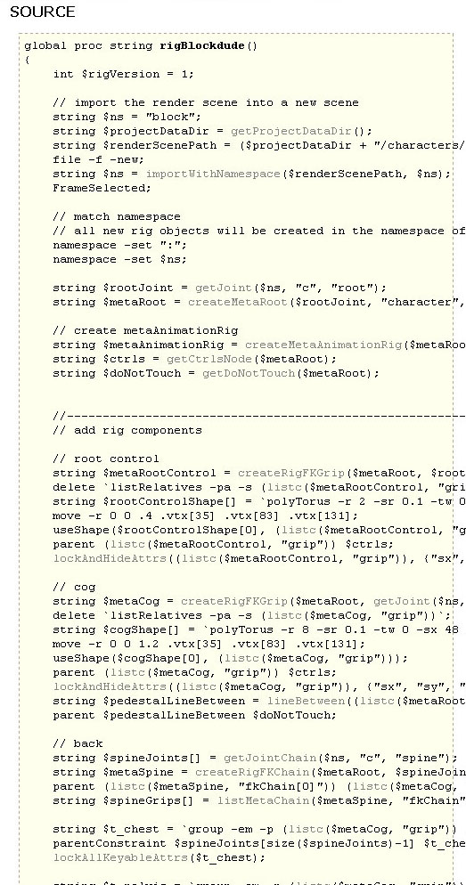
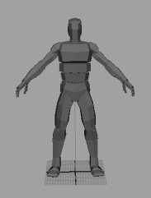
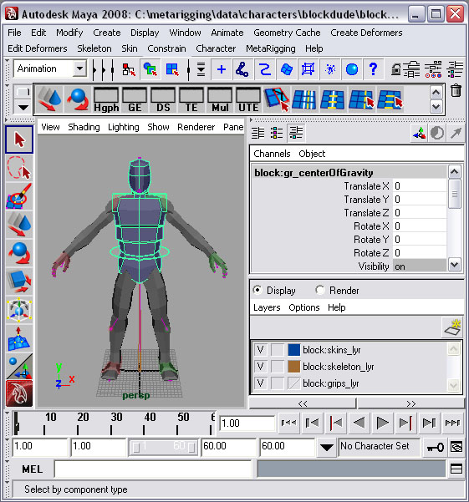
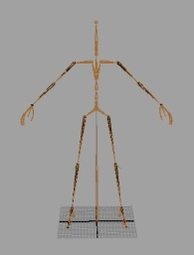
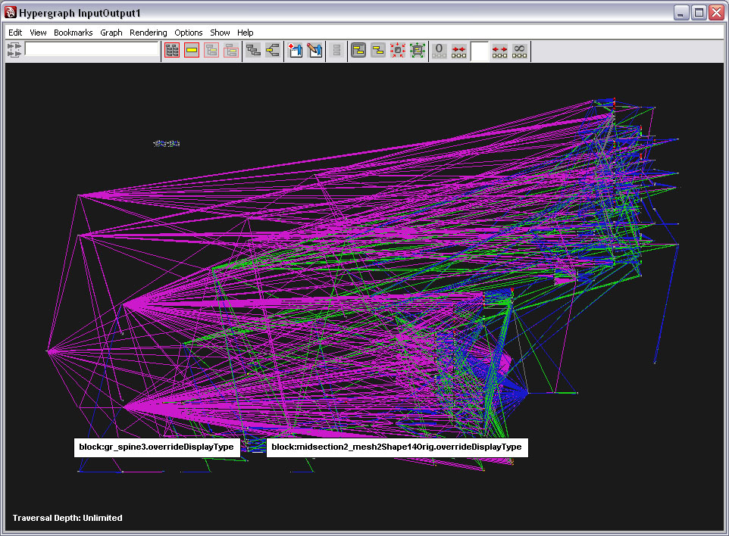
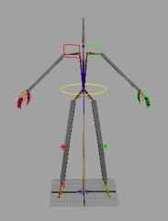
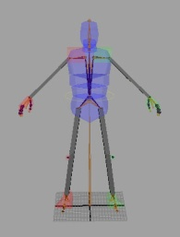
Computer Animation is a Complicated Web of Technical Confusion!
Halo 3 rig = 20,000 nodes
Dozens of Maya files build one rig
Thousands of copies of rig in animation scenes

Slide 9
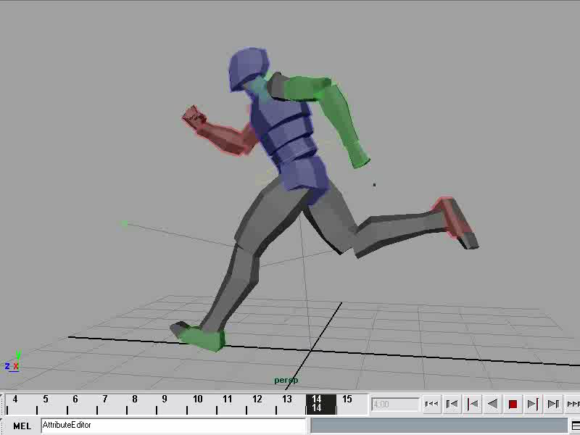
Rig == User Interface
UI Must be:
Intuitive
Efficient
Powerful
FUN!
Notes:
The rig is the animator’s interface
Advanced rig behavior is a requirement for modern day animation production

Slide 10
Tactical Realities of Large Scale Game Production
Industry Trends:
Larger games
More content, higher resolution
Shorter production cycles
Bungie: (Halo trilogy)
Sandbox game design
Large scale Cinematics production
Notes:
All of us in game development are up against huge production challenges because of the specifics of our game designs.
This poses significant challenges for content creators
At Bungie:
Sandbox game design
Large scale Cinematic production

Slide 11

Tactical Realities of Large Scale Game Production
Notes:
Combinatorial explosion: Need an animation for
each character
holding each weapon
for each seat of every vehicle
and each movement class.
Design driven – need full set of prototype animation immediately.
Cinematic production runs parallel to game development

Slide 12
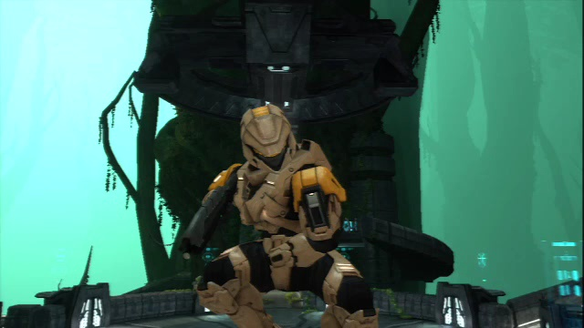
Tactical Realities of Large Scale Game Production
Notes:
In addition: Halo 3 Theater
Replay games and watch from any angle

Slide 13
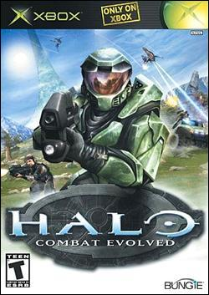
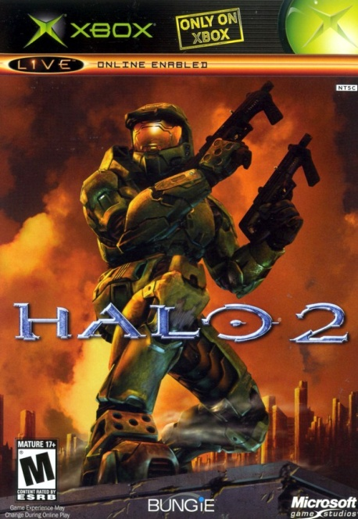

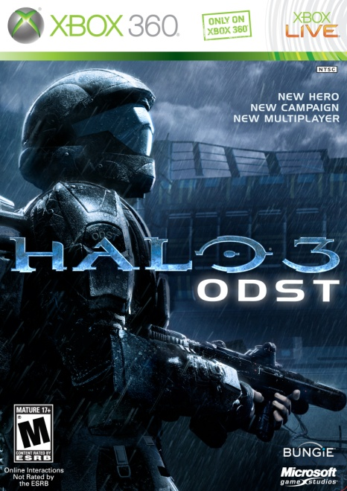
Tactical Realities of Large Scale Game Production
Gameplay prototyping starts before production green-light
Playtesting + iteration = fun games
Need all content immediately
Tech Artists:
Enable artists to iterate on existing content
Notes:
Design driven – need full set of prototype animation immediately.

Slide 14

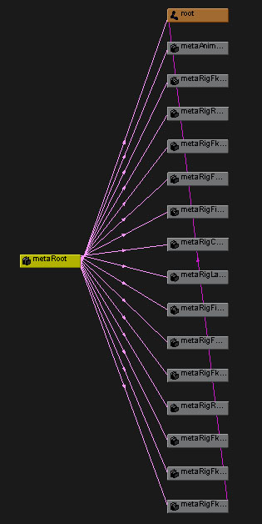
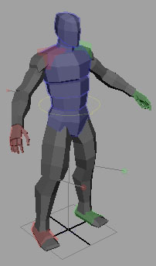
Biggest Rigging Challenge: Scene Traversal
Scripts traverse Maya scenes:
Add upgrades to rigs that are already animated
Tools to help animators work more effectively
Solution:
Standard metadata framework
Seamless script interface

Slide 15


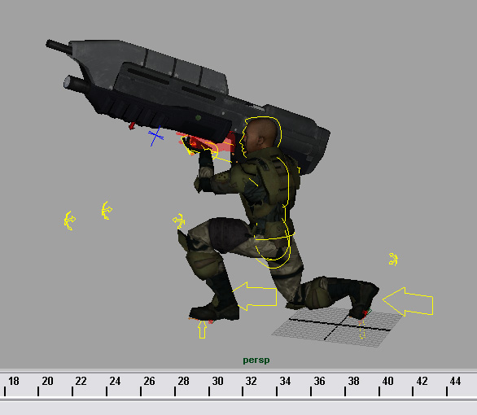
Scene Traversal Problem Example: Halo 3 Weapon Rig System
The Animators say:
We need a tool to add weapons to hands
It should align to the correct position as it does in the game
It should work with a simple button click
Must work on all characters with all weapons

Slide 16
Scene Traversal Problem Example: Halo 3 Weapon Rig System
global proc switchWeapon(string $weaponType)
{
if(size(`ls “b_handle”`)) delete “b_handle”;
file -import -t "mayaAscii" $weaponType;
parentConstraint “b_r_hand“ “b_handle";
}
Easy, right?
Import weapon
Constrain to right hand
Add switch mechanism for left hand

Slide 17
Scene Traversal Problem Example: Halo 3 Weapon Rig System
global proc switchWeapon(string $weaponType)
{
if(size(`ls “weapon”`)) delete “weapon”;
file -import -t "mayaAscii" $weaponType;
parentConstraint “b_r_hand“ “b_handle";
}
Easy, right?
Import weapon
Constrain to right hand
Add switch mechanism for left hand
Problem:
Markers and rig controls are named differently for each character and each weapon
Error: No object matches name “b_handle”.

Slide 18
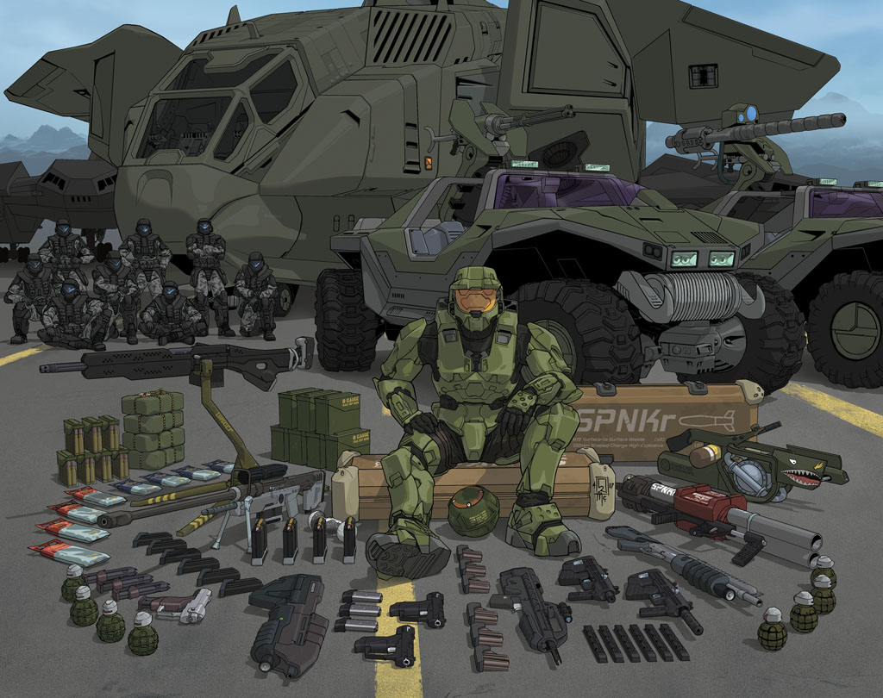
Scene Traversal Problem Example: Halo 3 Weapon Rig System
Massive amount of characters and weapons in Halo sandbox
~28 characters * ~35 weapons, = ~980 possible combinations

Slide 19
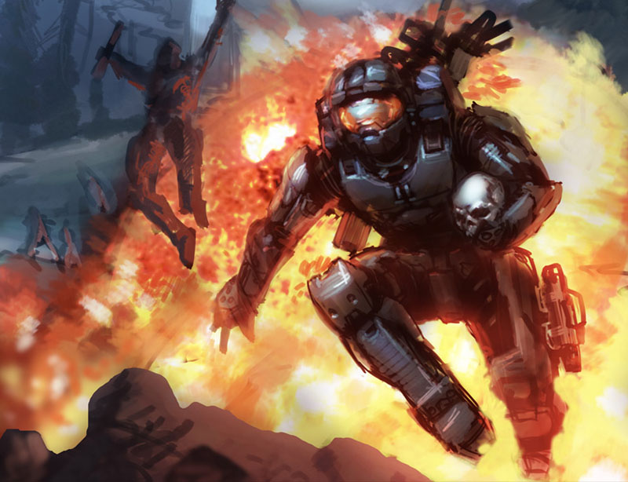
Explicit Scene Traversal (Illustrate the problem)
MEL/Python:
`ls` node names
`listRelatives` DAG
`listConnections` dependency graph
Problem:
Requires all rigs to be the same.

Slide 20

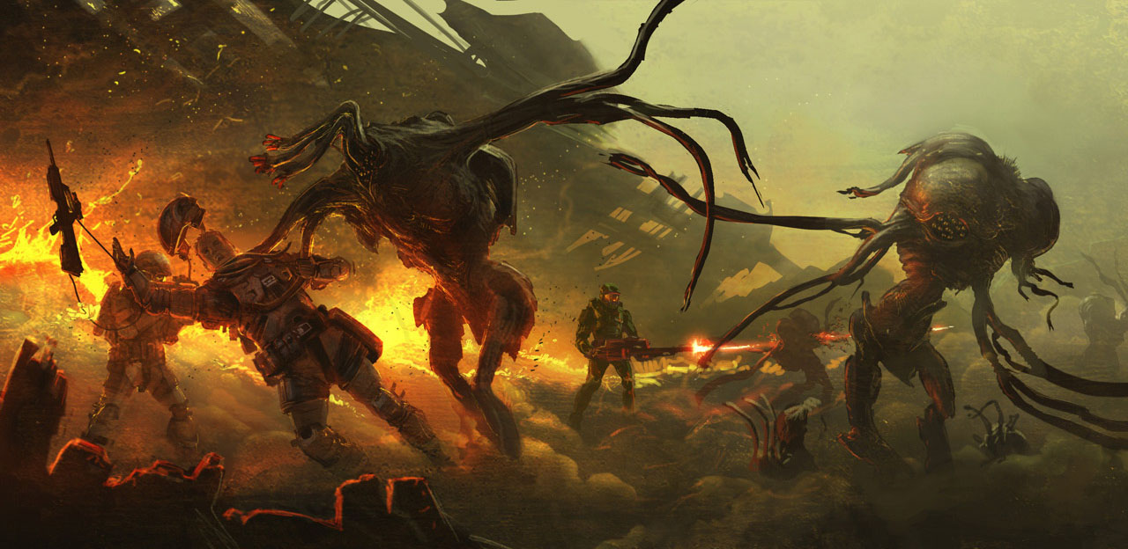

Hard-Coded Rig Data Conventions will eventually lead to this mess:
//depending on character type look for specific weapon markers
switch ($charType)
{
case "marine": //if marine type look for marine marker
$weaponMarker = ($namespace + "m_left_hand_marine");
if(!(`objExists $weaponMarker`))
{
//if marine marker doesnt exist try r marker
$weaponMarker = ($namespace + "m_left_hand_r");
if(!(`objExists $weaponMarker`))
{
//if r marker doesnt exist try generic left hand marker
$weaponMarker = ($namespace + "m_left_hand");
}
}
break;
case "odst": //if odst type look for odst marker
$weaponMarker = ($namespace + "m_left_hand_odst");
if(!(`objExists $weaponMarker`))
{
//if odst marker doesnt exist try r marker
$weaponMarker = ($namespace + "m_left_hand_r");
if(!(`objExists $weaponMarker`))
{
//if no r marker try marine
$weaponMarker = ($namespace + "m_left_hand_marine");
if(!(`objExists $weaponMarker`))
{
//try generic marker
$weaponMarker = ($namespace + "m_left_hand");
}
}
}
break;
case "brute": //if type brute
$weaponMarker = ($namespace + "m_left_hand_brute");
if(!(`objExists $weaponMarker`))
{
//if brute marker doesnt exist try generic
$weaponMarker = ($namespace + "m_left_hand");
}
break;
case "elite": //if Elite type
$weaponMarker = ($namespace + "m_left_hand_elite");
if(!(`objExists $weaponMarker`))
{
//if elite doesnt exist try generic
$weaponMarker = ($namespace + "m_left_hand");
}
break;
case "jackal": $weaponMarker = ($namespace + "m_left_hand_jackal");
if(!(`objExists $weaponMarker`))
{
//if jackal doesnt exist try generic
$weaponMarker = ($namespace + "m_left_hand");
}
break;
case "masterchief": $weaponMarker = ($namespace + "m_left_hand_mc");
if(!(`objExists $weaponMarker`))
{
//if mc doesnt exist try cyborg
$weaponMarker = ($namespace + "m_left_hand_cyborg");
if(!(`objExists $weaponMarker`))
{
//if cyborg doesnt exist try generic
$weaponMarker = ($namespace + "m_left_hand");
}
}
break;
default: $weaponMarker = ($namespace + "m_left_hand"); break;
}
Combine all traversal:
“Conditional Hell”
AKA “spaghetti code”

Slide 21
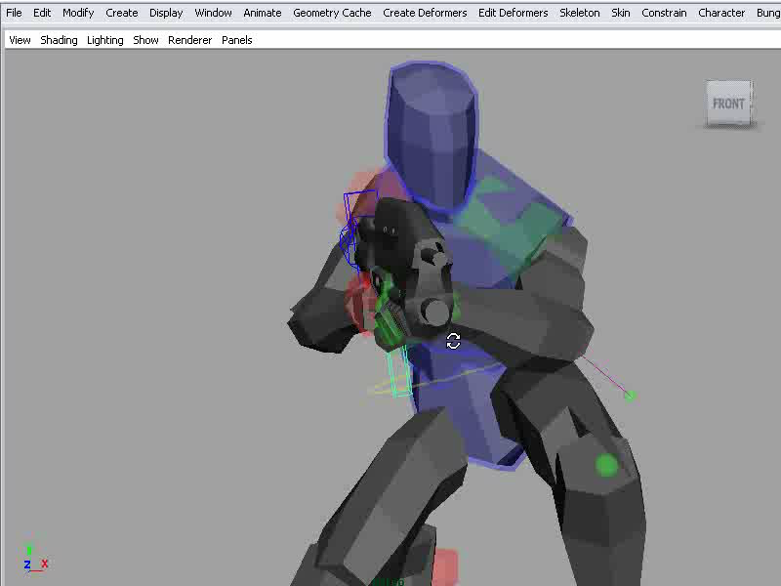
Notes:
Here is the fully functional weapon rig tool.
It uses the technique of Semantic Traversal to connect script code to rig data in the Maya scene.
It has rig controls that automatically align to the handle and stock.

Slide 22
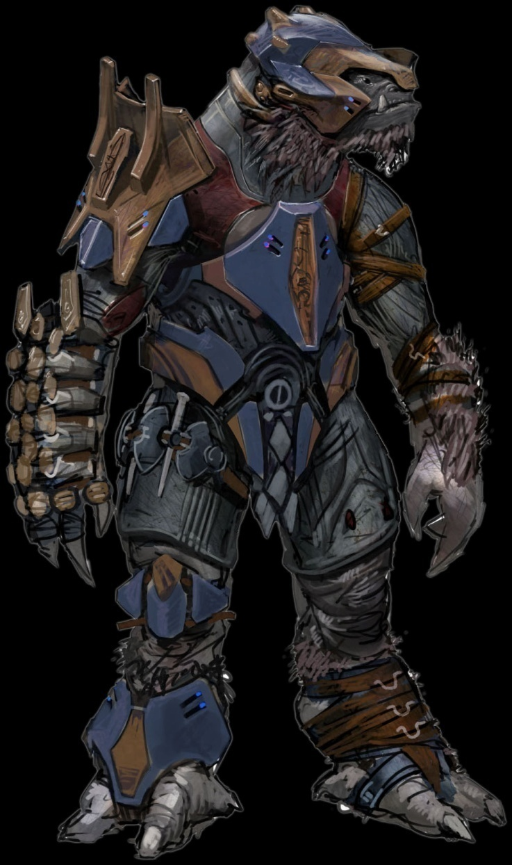
Olde Solutions to the Problem of Scene Traversal
Be strict about maintaining conventions:
Node names
Hierarchy
File names
Directory Structure

Slide 23
Olde Solutions to the Problem of Scene Traversal
Be strict about maintaining conventions:
Node names
Hierarchy
File names
Directory Structure
Problems with this approach:
Brittle. Even under the best conditions it will break down
Forces everyone to work one way: this limits creativity
Makes the Rigger the bad guy
That sucks!!!

Slide 24
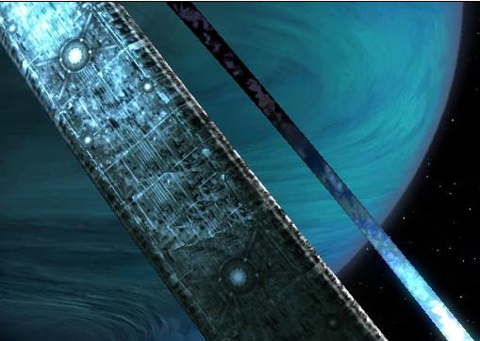
Other Solutions to the Problem of Scene Traversal
Cut content from the game?
Hire an army of grunt-class technical artists to manually fix everything?
Notes:
<read the slide>

Slide 25
Other Solutions to the Problem of Scene Traversal
Cut content from the game?
Hire an army of grunt-class technical artists to manually fix everything?
Build a Metadata Node Network to enable our scripts to use Semantic Traversal.
Notes:
<read the slide>

Slide 26

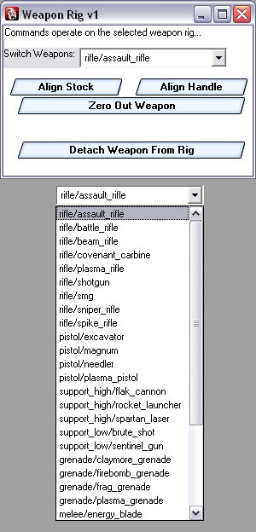
Designing Systems for Semantic Traversal
Pseudo-code example:
string $leftElbow =
getRigControl($metaRoot, “left”, “elbow”);
Clean and simple.
It just works.

Slide 27
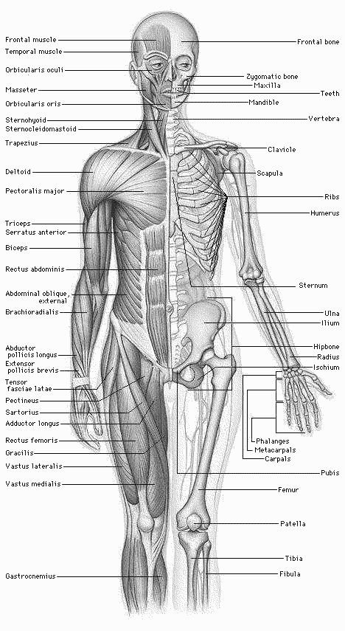
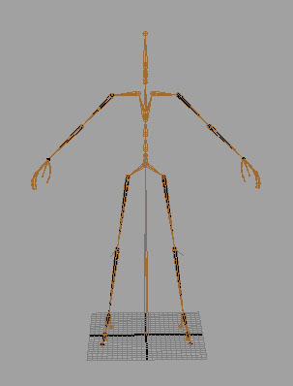
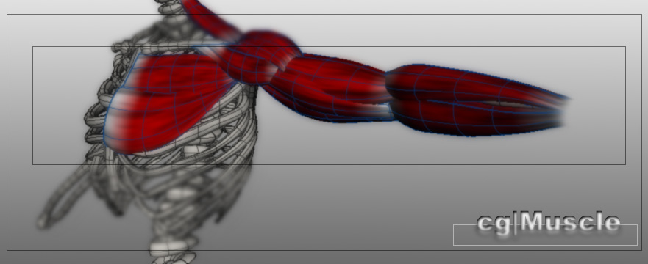
Designing Systems for Semantic Traversal
Rig Anatomy
Skeleton ==
Muscles ==
Image credit: Judd Simantov

Slide 28
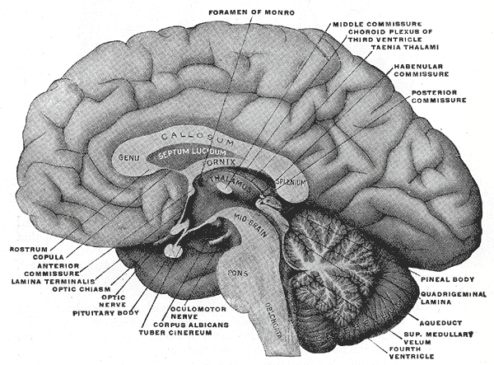
Designing Systems for Semantic Traversal
Rig Anatomy
Skeleton
Muscles
Brain ==

Slide 29
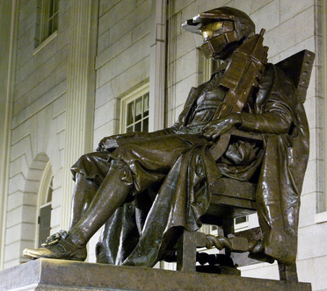
Designing Systems for Semantic Traversal
Metadata Design Philosophies:
Asset Centric
Keep script logic separate from:
Content data
User Interface
Future-proof:
Modular
Extensible
Bomb-proof:
Keep it simple

Slide 30
Designing Systems for Semantic Traversal
Mechanisms for tracking rig data
Maya scene graph:
Nodes, attributes and connections
DAG (Directed Acyclic Graph)
Dependency Graph
Custom metadata graph:
Build our own DAG structure in the DG
Notes:
(notes:) Make the DG work like the DAG
Emphasize that it can be used for all kinds of things other than just character rigs

Slide 31
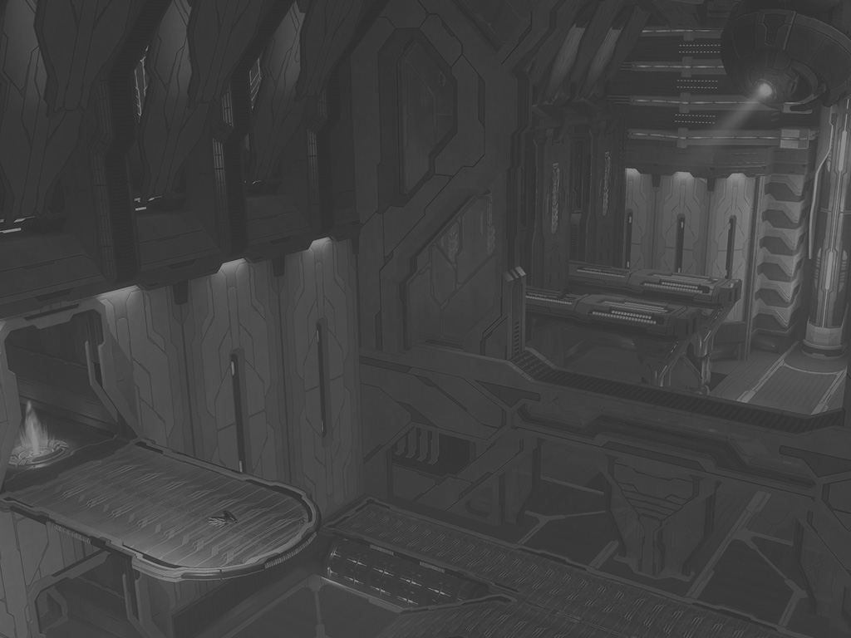
Building a Metadata Node Network
Disclaimer!
There are a million ways this could be done.
None are perfect.
At best some are less wrong than others.
This is what we chose to do based on what we learned on the production battlefield.
And it has worked quite well so far ☺

Slide 32
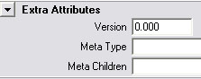
Building a Metadata Node Network
global proc string metaNode(string $metaParent, string $metaType)
Node type: “network”
Connect metaNodes to rig nodes with:
stringAttr → messageAttr
Add standard attrs to all metaNodes
metaType (string)
version (int)
metaParent (message)
metaChildren (string)
Later we will add more attrs to metaNode types as necessary.

Slide 33
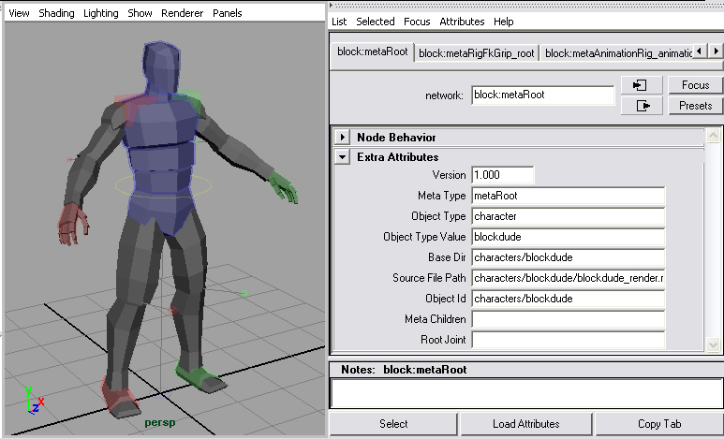
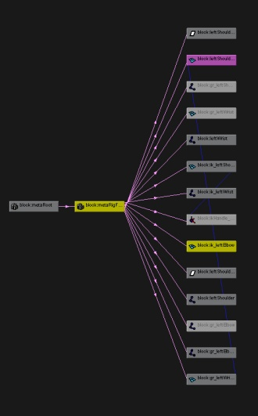
Building a Metadata Node Network
MetaRoot
All metaNodes connect “upward” to metaRoot
Directional graph like DAG in the DG (can bend rules)
MetaRoot stores global object info (asset centric)
global proc string metaRoot(string $rootJoint, string $objectType, string $objectTypeValue, string $objectId, string $sourceFilePath);

Slide 34

Building a Metadata Node Network
Semantic Traversal Functions:
Analogous to MEL/Python`listRelatives`
def listMetaParent(node):
Crawl “up” the .metaParent connection
def listMetaChildren(metaNode):
Crawl “down” to metaNodes connected to .metaChildren attribute

Slide 35
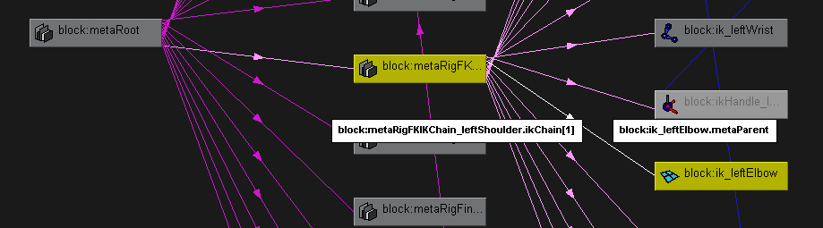
Building a Metadata Node Network
Semantic Traversal Functions:
def listMetaRoot(node):
A reliable way to get metaRoot from any node on the rig
def listMetaChildOfType(metaNode, $metaType):
Returns metaChildren of a given type
def listAllMetaChildren(metaNode):
Returns all metaNodes “below” the input metaNode

Slide 36
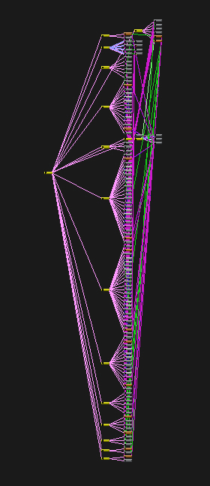
Building a Metadata Node Network
Semantic Traversal Functions:
def listMetaConnections(node):
Returns a list of all metaNodes connected to the input node (non hierarchical)
def listSingleConnection(node, attr):
Gets a specific node connected to the input node.attribute plug

Slide 37
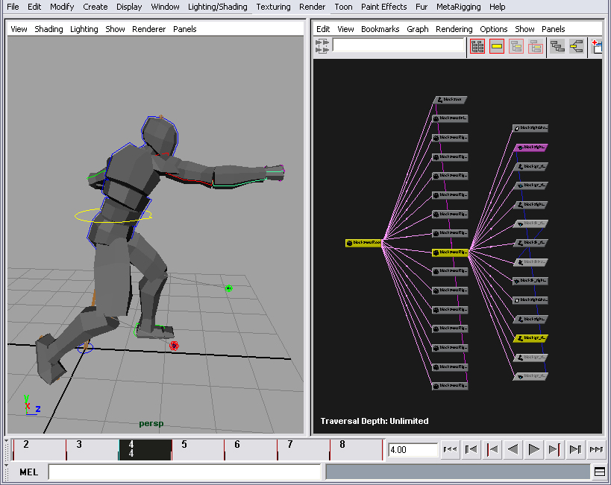
Building a Metadata Node Network
Keep track of important nodes on character rigs with custom connections to metaNodes
Advantages
Easy to maintain
Scripts don’t have to guess
Allows you to build more complex rig behaviors
Great for custom tool building

Slide 38
Building a Metadata Node Network
When is the metaNode network added to the rig?
MetaNode network is added at the time of rig creation
Modular Procedural Rigging for the win.

Slide 39
Modular Procedural Rigging
Notes:
Now let’s take the concept of the Metadata node graph and use it when building animation rigs.
Modular Procedural Rigging is the concept of automatically creating similar rig components for different parts of the body.
We’ll think of the body in terms of regions as Jason Schleifer discussed in his Masterclass, Animator Friendly Rigging. Back, Neck, Arms, Legs, Fingers, Face.

Slide 40
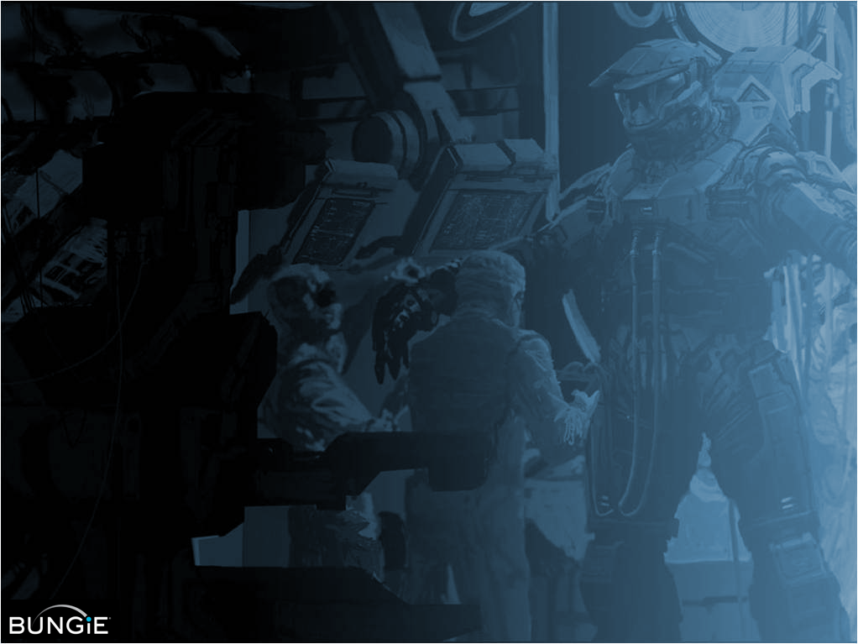



Modular Procedural Rigging
Utility Scripts
Rig Component Scripts
Rig Template
Scripts
Common general purpose functions
Scene traversal
Namespaces, strings, import/export, etc.
FK/IK Chain
Stretchy Spline IK
Multi-constraint
Procedural Fixup
One or more per character or object
Consistency
Custom rigging

Slide 41
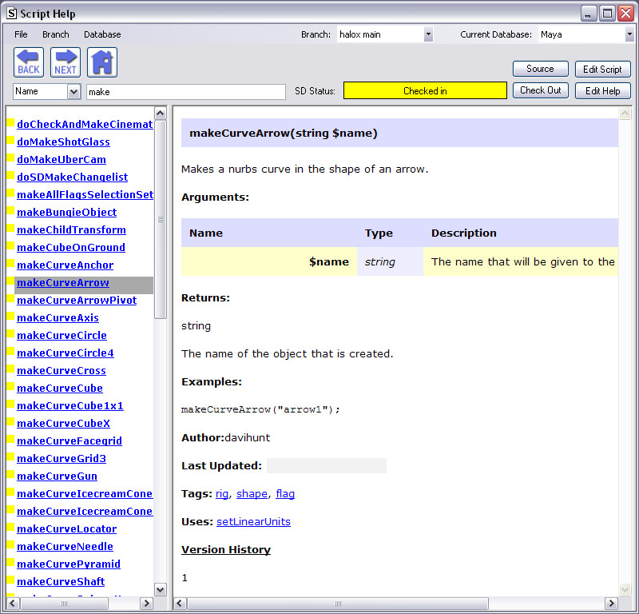
Modular Procedural Rigging
Script Help tool
900+ scripts!
Integrated code documentation
Collaboration Infrastructure

Slide 42
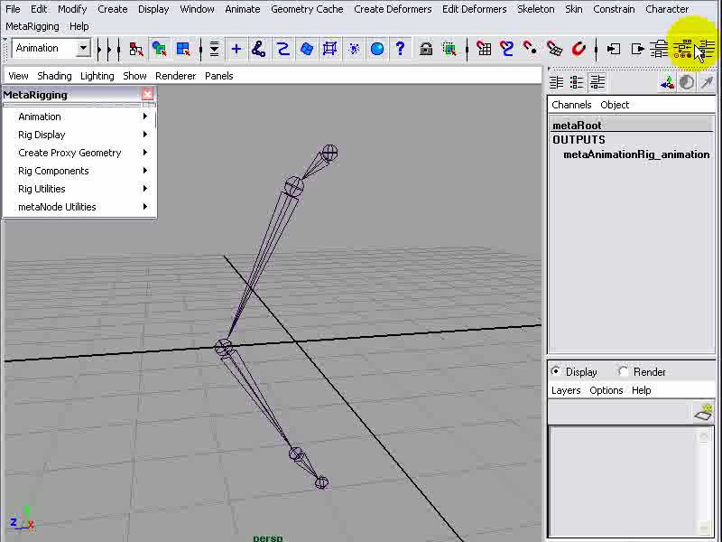
Modular Procedural Rigging
Simple IK
Rig Component
Instant creation
No human error
Can add multiple copies to the same rig
Consistent with other rigs
Notes:
Click, Click, Bang!

Slide 43
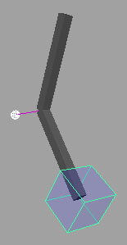
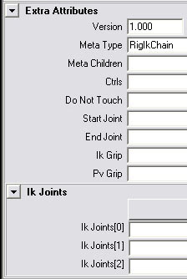
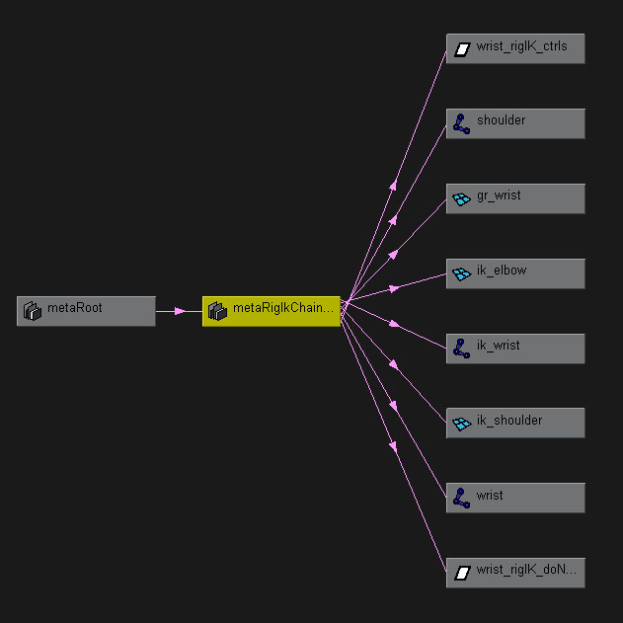
Modular Procedural Rigging
Simple IK Rig Component
Metadata
Rig node connections
Notes:
Problem: This rig component is too simple for an arm rig. Need FK/IK switching

Slide 44
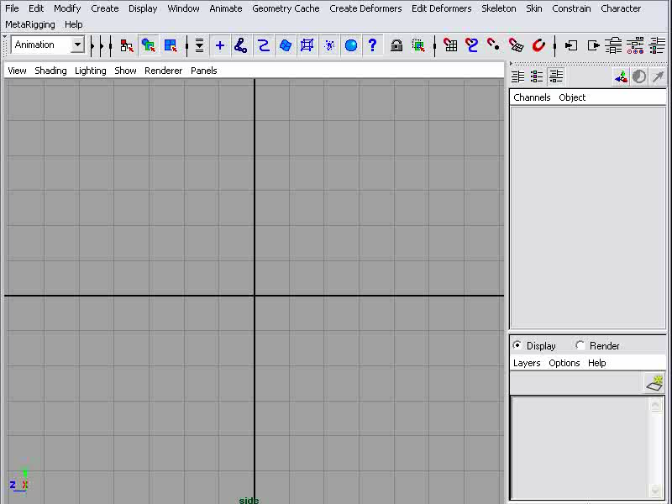
(not) Modular Procedural Rigging
Manual Rigging: (how NOT to do it) Simple IK Rig
Draw joint chain
Add IK handle
Constrain control object
Add pole vector control
Promote twist attribute
Lock and hide unused attrs
Add top level organizational groups:
ctrls group
doNotTouch group
all group

Slide 45
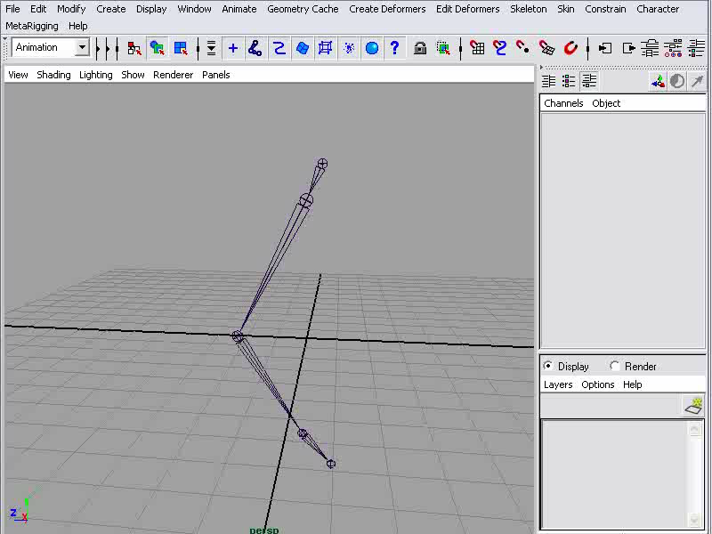
Modular Procedural Rigging
Procedural Rigging:
FK/IK Rig Component
Math-node driven switch mechanism between FK/IK
Switch attr instanced onto all rig controls
Switch/Align enabled by semantic traversal
Right click menu

Slide 46



Modular Procedural Rigging
FK/IK Rig Component
Metadata
Rig node connections

Slide 47

Modular Procedural Rigging
Rigging a complete character using
Modular Rig Components
Fast and easy to create
~5 minutes
Allows for custom rig configurations

Slide 48



Modular Procedural Rigging
Rigging a complete character using
Modular Rig Components
Metadata
Rig node connections

Slide 49

Modular Procedural Rigging
Rig Template Script Modular Rig Components:
BAM!
Rig is generated automatically
Enables fast iteration
Production friendly

Slide 50





Cinematic Animation Tools
Shots are metaNodes
Non-linear editing tool

Slide 51


Modular Procedural Rigging
Faceplanes:
Advanced Rig Component
Fluid, naturalistic interpolation for facial bone animation
Too complex to edit by hand without assistance from tools →

Slide 52


Slide 53


Facial Animation Rig (on the inside)
NURBS point on surface
Deformation joints
Set-Driven-Key poses
Face Toolbox UI: universal parametric controls

Slide 54


Faceplane Rig Component

Slide 55

Distributing Rig Updates
Xrig Live
Rig Update Tool
Alternative to File Referencing
Distributes updates to rigs/components through MetaNodes
Database back end
Riggerscore!
Notes:
That lead to what we use today to handle rig updating: Xrig Live. It is basically our own form of file referencing.
It tracks version number on all parts of the rig and allows us to run update scripts throughout our scenes.

Slide 56

ReAnimator
Skeleton-to-Rig Retargeting
Notes:
Our tool ReAnimator allows animators to pull motion from other sources.
Skeleton to rig retargeting
Transfer motion to rig
Pose ripping
Export rig motion to baked skeleton

Slide 57


Slide 58

Skeleton Pose Tool
How it works:
Uses alignRigToSkeleton() from ReAnimator
Saves copies of skeleton into “\poses\” folder.
Import skeleton, align rig and delete.
Discussion: skeleton-to-rig vs. rig-to-rig pose system

Slide 59








Animation Tools That Leverage The Metadata Node Network

Slide 60

The Way Forward
Thoughts on the future of Rigging and Animation
Open Source Animation
Tools-Based Rigging

Slide 61

The Way Forward:
Open Source Animation
Leverage multiple motion sources:
Hand keyframe, Dynamics, Mocap
Challenge: baked keyframe data
Solutions:
Animation layers
Animating without a rig???
Notes:
Rick Lico: new animation lead. Technique of: Open Source Animation.
Using multiple input sources for character motion
hand keyframed
physics simulations
motion capture.
Challenge: working with baked keyframe data
Animating without rig: locator/constraint tricks, layers

Slide 62

Notes:
Here is a video of Rick animating without a rig.
Add modular rig components on the fly
Worldspace rotation
Freeform IK (FIK)
Inverse Forward Kinematics (IFK)
Animation layers

Slide 63


The Way Forward:
Tools-Based Rigging
Combine Modular Procedural Rigging with Open Source Animation
Make use of a wide variety of motion sources
No more need for the rig update system!
Techniques:
ReAnimator skeleton to rig motion transfer
Rig Component Tools: bake on, bake off
Localized Semantic Traversal
Use animation layers
Rig requirements:
Rig driven by baked skeleton
Simple core rig, advanced tool/UI contexts
Parametric animation for the face

Slide 64

Notes:
Here is another animation made by Rick using a combination of the Modular Procedural Rig and the Open Source Animation tool techniques. It was made even faster than the previous animation and with all of the same baked keyframe editing techniques.

Slide 65


The End
Questions and answers
Bungie is hiring! jobs@bungie.com
Contact: davihunt@bungie.com

